Slide 1
HOTEL MANAGEMENT SYSTEM
RNS INSTITUTE OF TECHNOLOGY
BENGALURU - 98
DEPARTMENT OF INFORMATION SCIENCE & ENGINEERING
Presentation on DBMS Mini Project Work
Sameer Singh Sharanya RP
1RN20IS131 1RN20IS143
Date: 11-01-2023
Time:
Guide
Mr. T S Bhagavath Singh
Associate Professor, Dept. of ISE, RNSIT
Lab in Charge
Dr. R Rajkumar
Associate Professor, Dept. of ISE, RNSIT

Slide 2
AGENDA
Abstract
Introduction
Literature Survey
Requirements
ER-Diagram
Schema Diagram
Flowcharts
Results
Snapshots
Applications
Conclusion
References

Slide 3
ABSTRACT
Our project is a to create a hotel management system which will make booking a hotel a seamless and hassle-free experience.
It also provides a smooth experience to the admin who is able to view all the information in regards to rooms, reservations and users currently using the system.
With the increasing trend of “all things online” our system enables that and also reduces person to person contact through a digital method.

Slide 4
INTRODUCTION
The purpose of this project is to make a hotel management system to make it easier to manage rooms in a hotel.
Rooms can be booked based on their category and the available dates. When booking the system checks the check-in and the check-out dates to see if there the room is booked.
Users can book a hotel easily and with a seamless experience.
An admin user can also manage the details of rooms, view bookings, view users, add rooms and delete rooms.

Slide 5
LITERATURE SURVEY
Traditional File System
The traditional approach to data handling offered a lot of the convenience of the manual approach to business processes (ex. handwritten invoices & account statements, etc.) .
Initially, these separate systems were very simple to set up as they mostly mirrored the business process that departments had been doing for years but allowed them to do things faster with less work. However, once the systems were in use for so long, they became very difficult for individual departments to manage and rely on their data because there was no reliable system in place to enforce data standards or management.
Pros:
Simple
Initially low cost
Cons:
Unmanaged redundancy
Lack of data sharing and higher costs in the long run

Slide 6
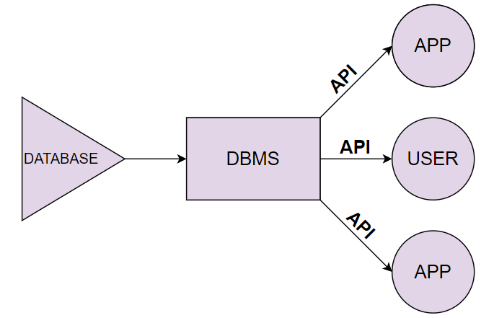
LITERATURE SURVEY
Database Management System
A database management system (DBMS) refers to the technology for creating and managing databases. Basically, a DBMS is a software tool to organize (create, retrieve, update and manage) data in a database.
The main aim of a DBMS is to supply a way to store and retrieve database information that is both convenient and efficient.
Advantages of a DBMS
Data independence
Efficient data access
Data security
Components of a DBMS
Users and DBMS
Database and database applications

Slide 7
REQUIREMENTS
Hardware Requirements
The hardware requirements are very minimal and the program can be run on most of the machines
Processor : Qualcomm Snapdragon processor
Processor Speed : 1.4 GHz
RAM : 2 GB
Storage Space : 10 GB
Display Resolution : 1024*768
I/O Elements : Camera, Speaker, Microphone, GPS Network : 5 Mbps

Slide 8
REQUIREMENTS
Software Requirements
A PHP engine : Version 5. Included in XAMPP-Windows.
A web server : Apache HTTP Server 2.2 is recommended. Included in XAMPP Windows.
A database server : MySQL Server 5.0 is recommended. Included in XAMPP Windows.
A PHP debugger(optional) : XDebug 2.0 or later.

Slide 9
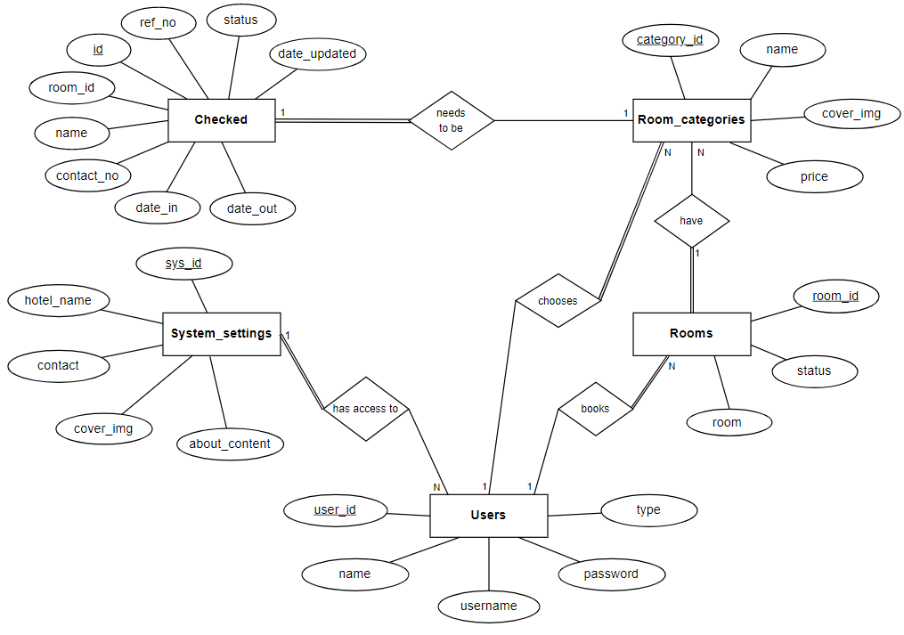
System Design-ER Diagram

Slide 10
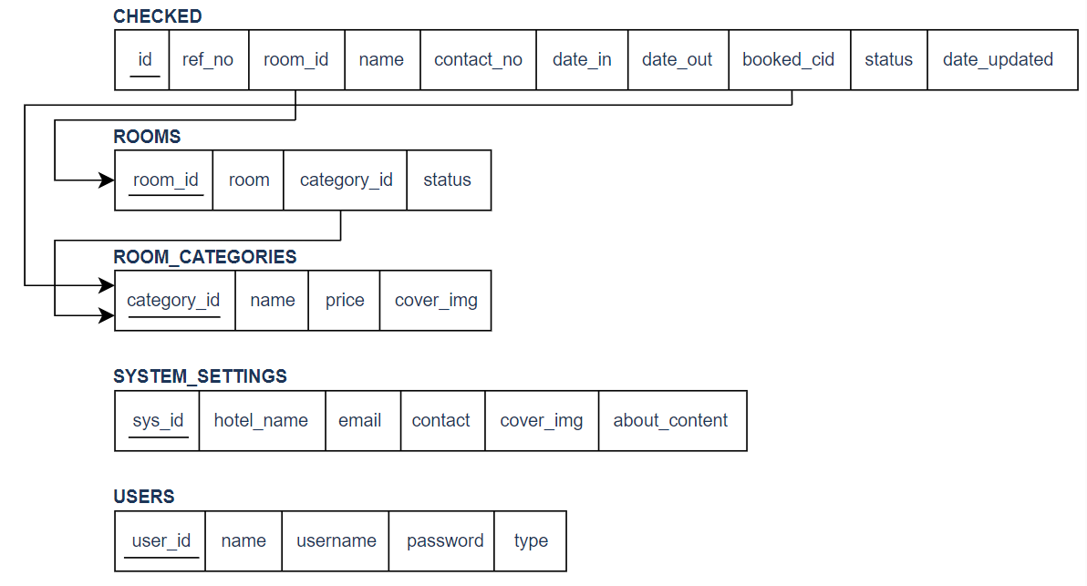
Detailed Design-Schema Diagram

Slide 11
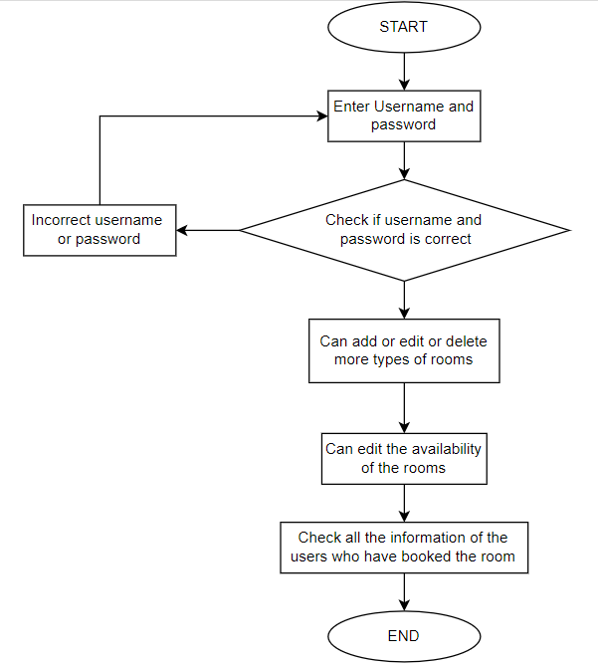
Implementation
Flowchart of Admin

Slide 12
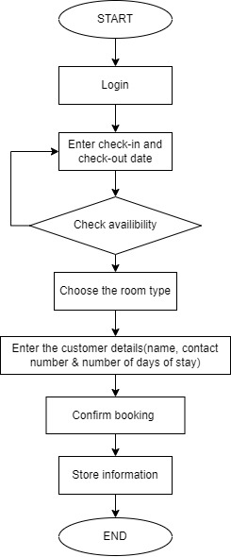
Implementation
Flowchart of User

Slide 13
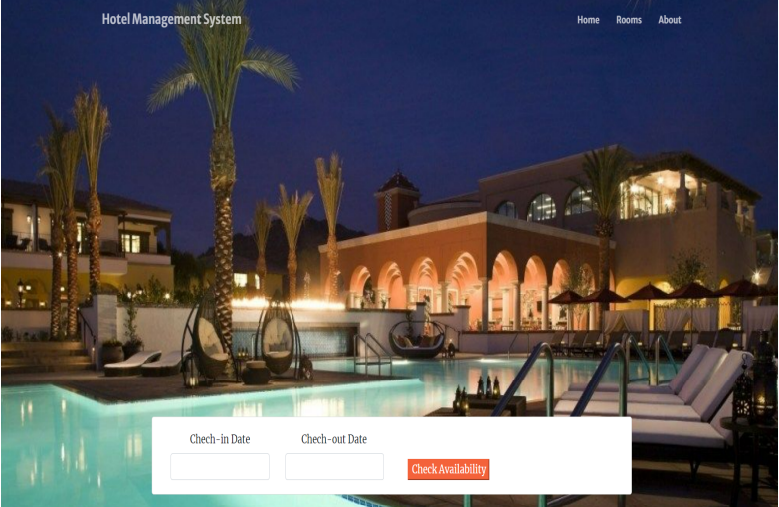
Results and Snapshots
Home page of user
This figure is the home page of a hotel management system where the user can enter the check-in date and check-out date and check the availability of the rooms.

Slide 14
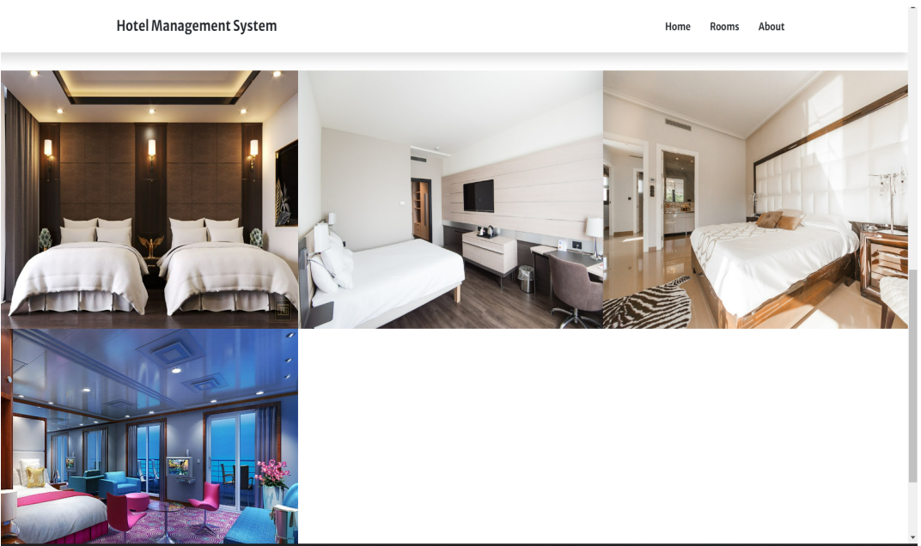
Results and Snapshots
Hotel rooms
This figure displays the different hotel rooms the users can book according to their given dates of stay.

Slide 15
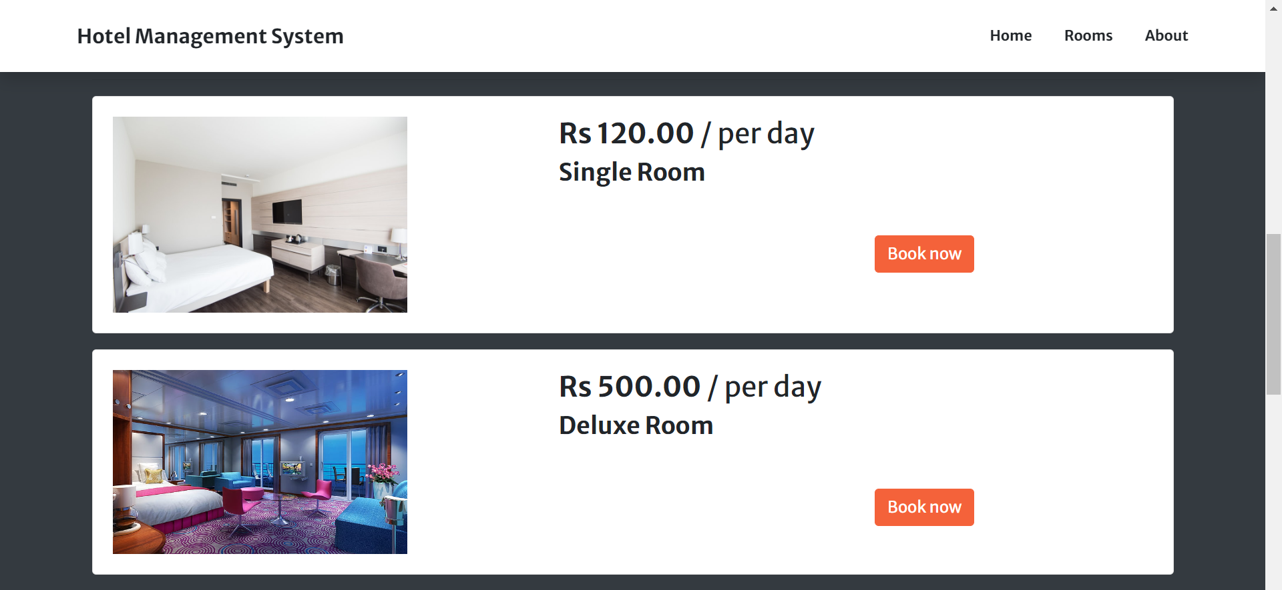
Results and Snapshots
Hotel rooms
This figure shows all the hotel rooms along with prices of the particular room that you can book accordingly.

Slide 16
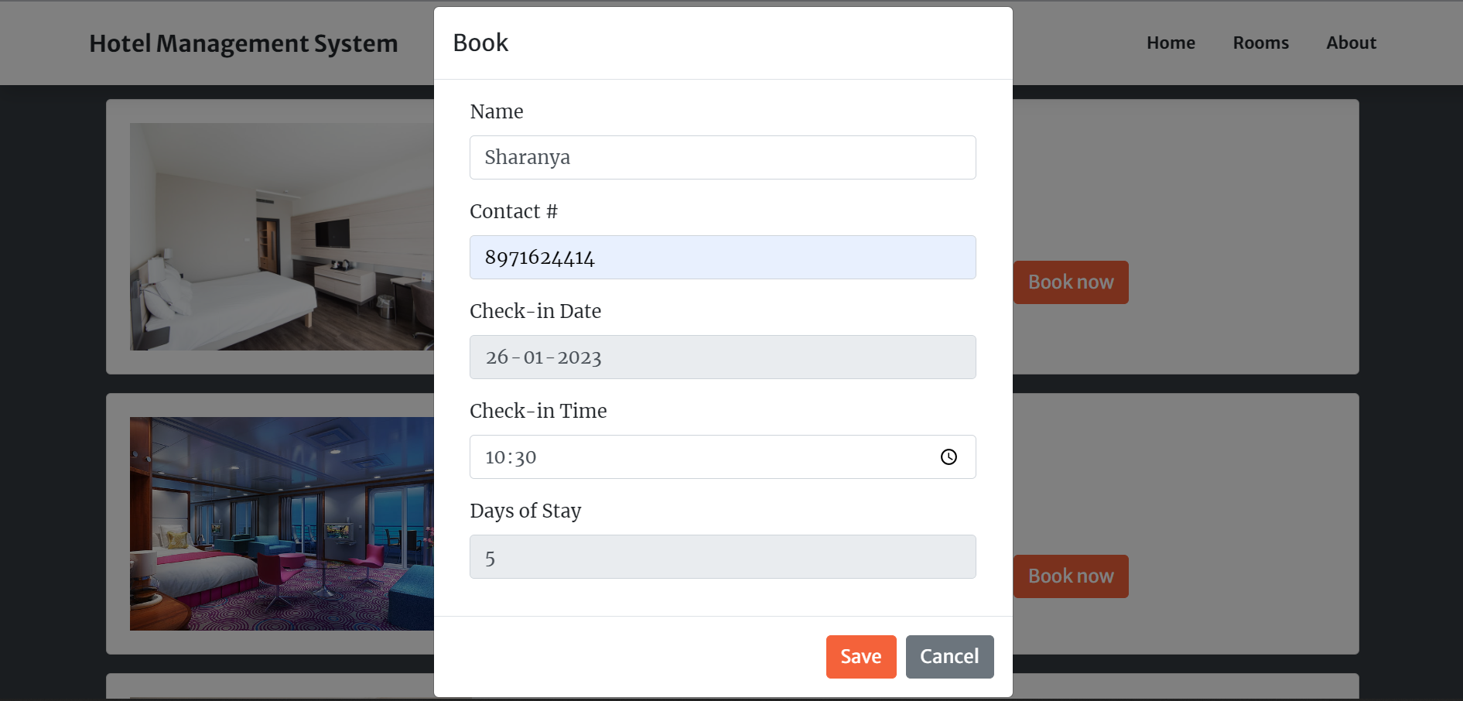
Results and Snapshots
Detailed section
This page shows the details that user will be entering after selecting the type of room to be booked.

Slide 17
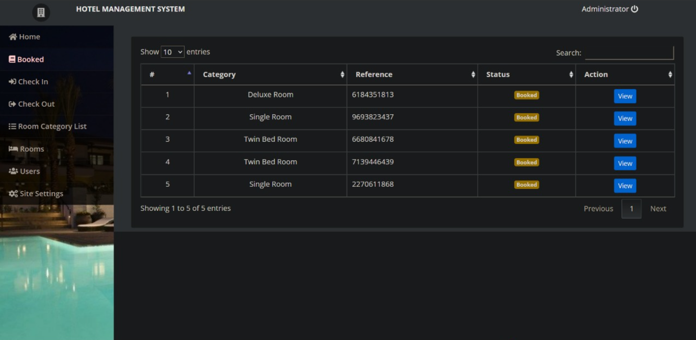
Results and Snapshots
Booked page of admin
This figure shows all the booked rooms along with the details and the current status of the room.

Slide 18
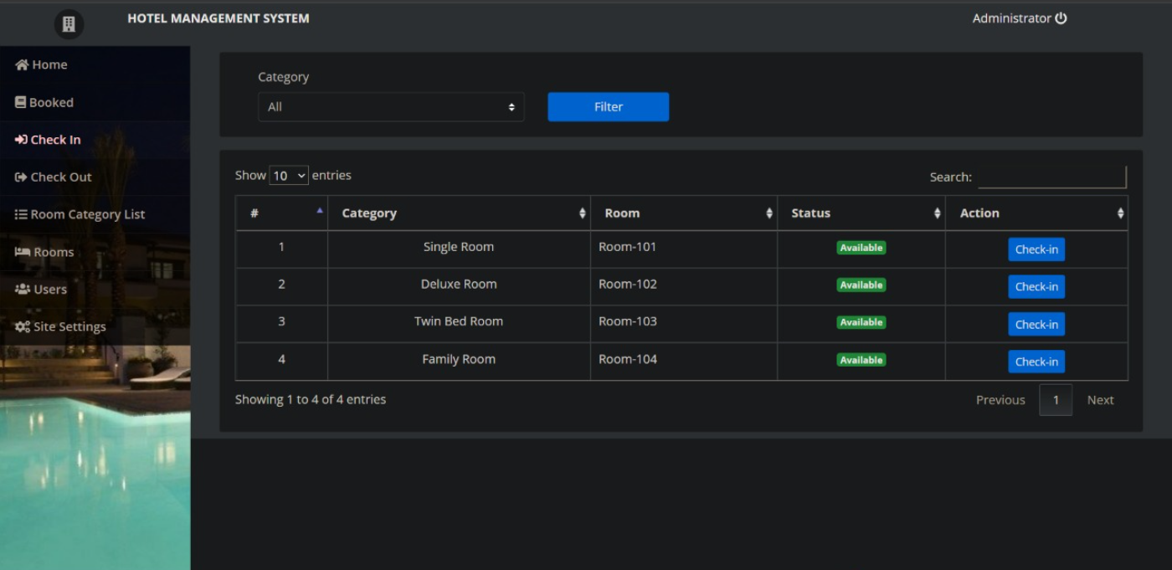
Results and Snapshots
Check-in details page in admin
This figure shows the check-in details about the room, room category, room number and also the status of the room.

Slide 19
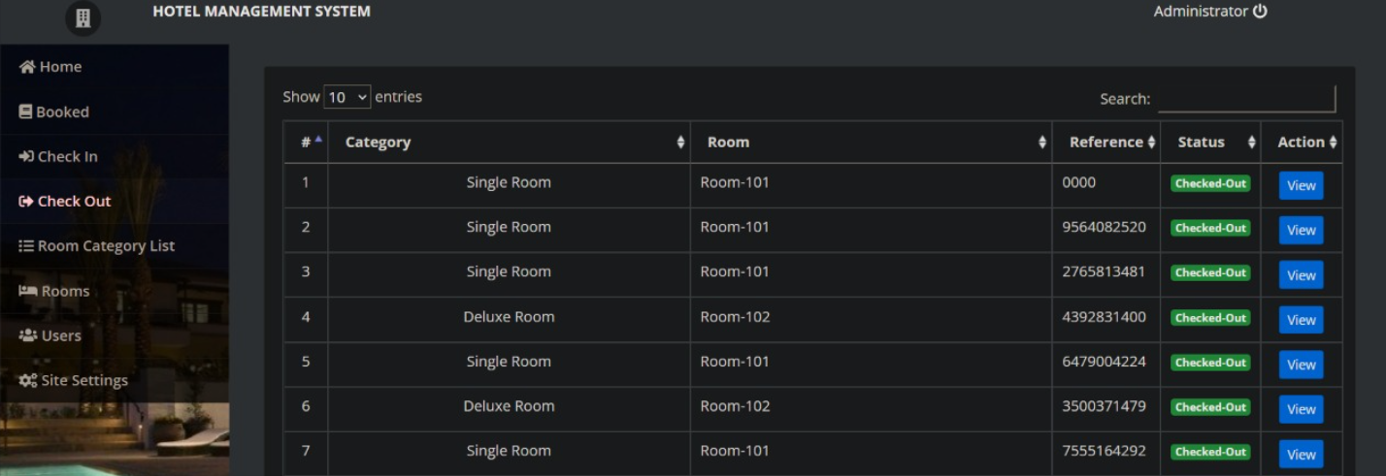
Results and Snapshots
Check-out details page in admin
This figure shows the check-out details about the room, room category, room number, status of the room and he reference number.

Slide 20
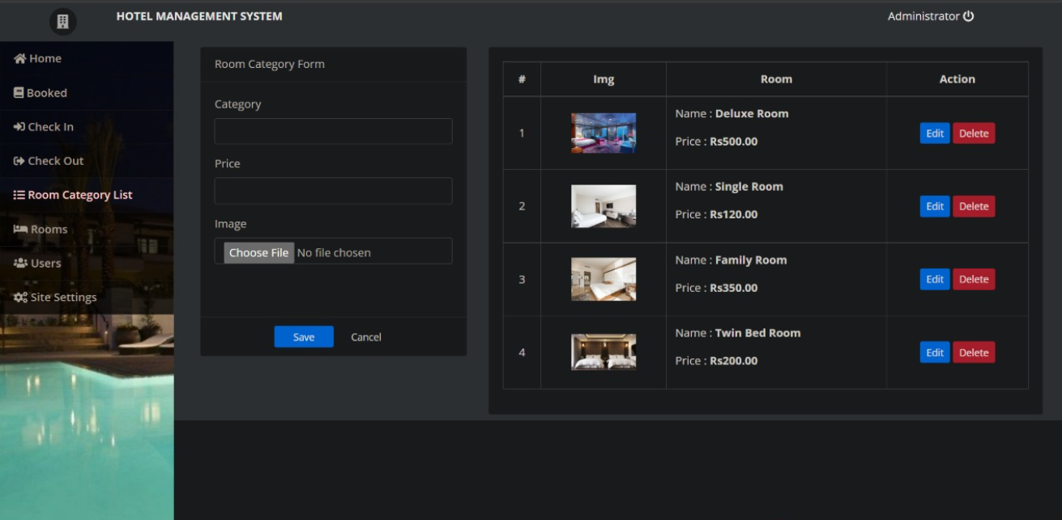
Results and Snapshots
Room category list page in admin
This figure shows that the admin can add more room categories and also edit the existing ones along with the prices.

Slide 21
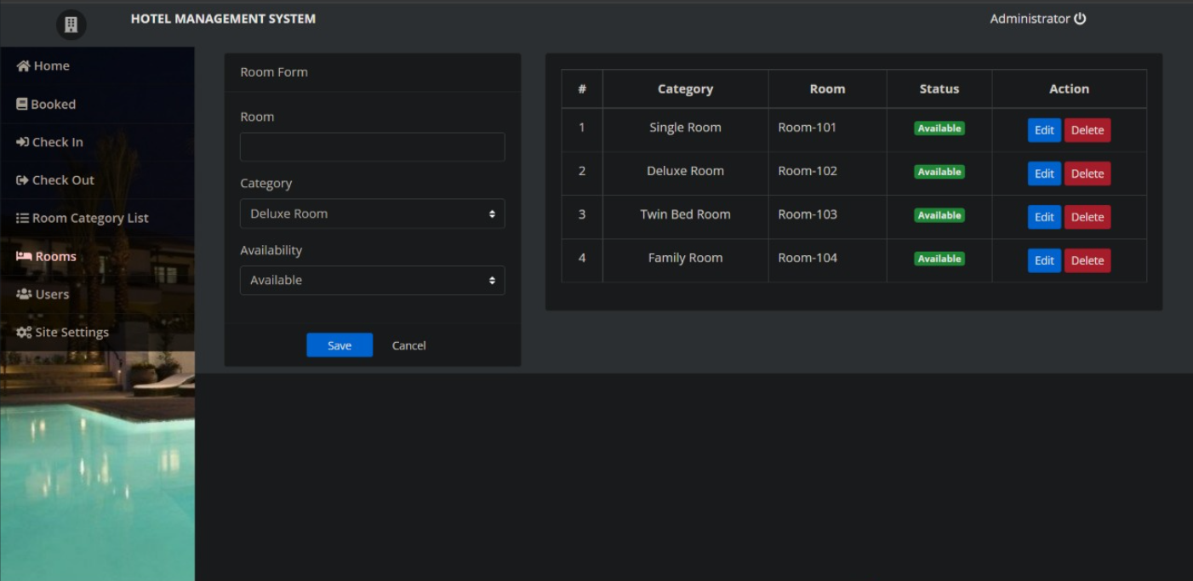
Results and Snapshots
Rooms page in admin
This figure shows that the admin can add more rooms in a particular type of room category and also edit the previously created rooms.

Slide 22
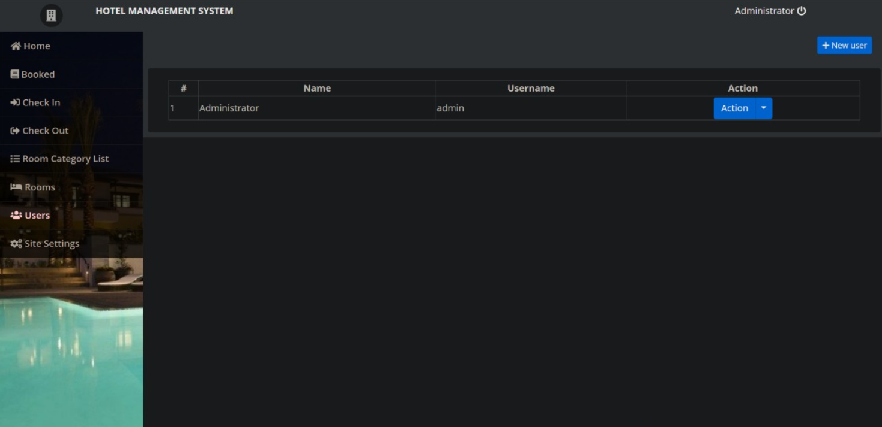
Results and Snapshots
Users page in admin
This figure shows the name, username and the actions of the admin.

Slide 23
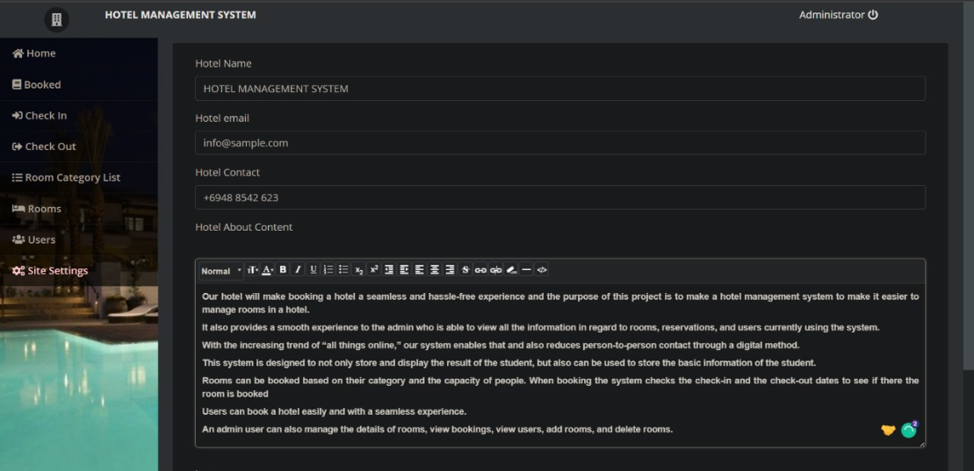
Results and Snapshots
Site settings page in admin
This figure shows that in this page the site name, email address and contact can be changed.
We can also write about the website here which will be displayed on the actual website.

Slide 24
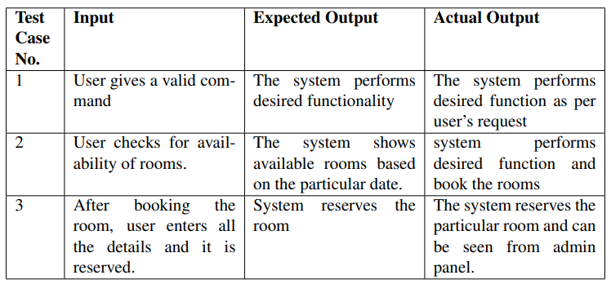
Testing
Test case validation for Hotel Management System :

Slide 25
Applications
This system will be performing the following tasks:
The system will provide an interface to login and register.
Check the features of the room along with a pictorial view.
Rooms can be booked based on their category.
An admin user can also manage the details of rooms, view bookings, add rooms and delete rooms.
A created account includes the information such as date of name, phone-number, email and reference numbers. All this data is stored in the database.

Slide 26
CONCLUSIONS
The Hotel Management system is a web based application. The main aim in this project was to make it seamless to book rooms at a hotel. It also is aimed to make the managing of the rooms and users easy and hassle free for the admin.
An appealing and intuitive user interface along with graphical representation of room information makes the user experience enjoyable for both customer and admin.

Slide 27
FUTURE ENHANCEMENTS
Mentioned points are the enhancements which can be done to increase the applicability and usage of this project :
We can add printers in future.
We can give more advance software for Hotel Management System including more facilities.
We will host the platform on online servers to make it accessible worldwide Integrate multiple load balancers to distribute the loads of the system.
Implement the backup mechanism for taking backup of codebase and database on regular basis on different servers.
Here we can maintain the records of Room and Customer.

Slide 28
REFERENCES
http://www.phpknowhow.com/basics/working-with-xampp
https://www.geeksforgeeks.org/dbms/
http://www.w3schools/php.com
https://github.com/mpdf/mpdf
https://javatpoint.com
https://mobiosolutions.com/create-or-execute-stored-
procedures-in-phpmyadmin/

Slide 29
Question and Answer

Slide 30
THANK YOU

